Slide 1
AUTOMOBILE SPARE PARTS SYSTEM

Slide 2
-> INTRODUCTION
This is a used automobile spare parts system
User can buy and sell their products here

Slide 3
-> SOFTWARE ENVIRONMENT
Front End : PHP
Back End : My SQL
Operating System : LINUX/ Windows
IDE : Adobe Dreamweaver CS5.5

Slide 4
-> EXISTSTING SYSTEM
The Existing system is either manual or system based.
May take considerable amount of time.
Proper utilization is not possible.
Low efficiency.
Not much effective.

Slide 5
-> PROPOSED SYSTEM
User can search and purchase their needed spare parts without any location limit.
Users interaction.
Quick search of all records.
Easy to use and reduce manual work.
User can market there spare parts anywhere.
It is user friendlier.

Slide 6
-> MODULE DESCRIPTION
Registration
Booking
Product Management
Communication
Payment
Cancellation & Refund

Slide 7
-> ACTORS AND THEIR ROLES
User ( Customer)
-> Registration
-> Add item
-> Delete item
-> Upadate item
-> Book item
-> Search
-> payment
-> Cancel & Refund
-> Communication

Slide 8
-> ACTORS AND THEIR ROLES
Admin
-> Registration

Slide 9
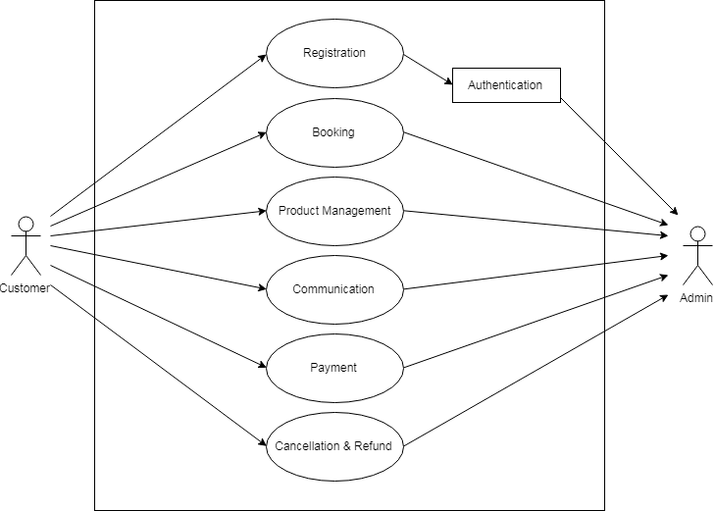
USECASE DIAGRAM

Slide 10
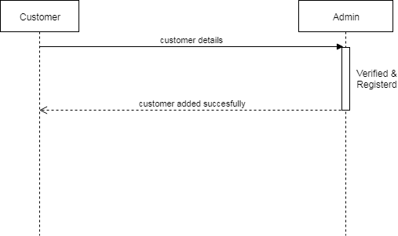
-> SEQUENCE DIAGRAM
Customer Registration

Slide 11
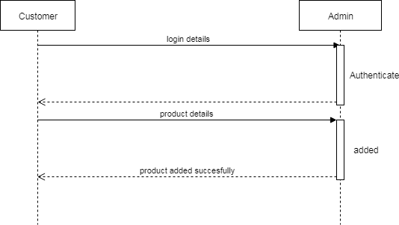
-> SEQUENCE DIAGRAM
Product Registration

Slide 12
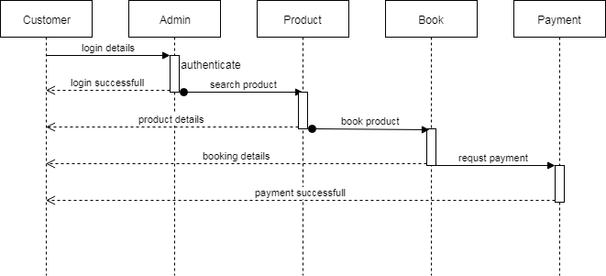
-> SEQUENCE DIAGRAM
Payment

Slide 13
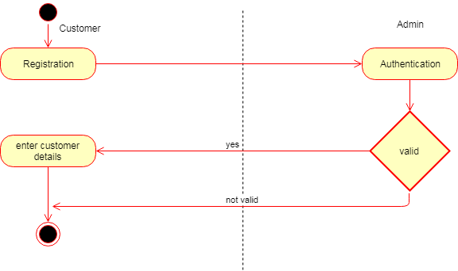
-> ACTIVITY DIAGRAM
Customer Registration

Slide 14
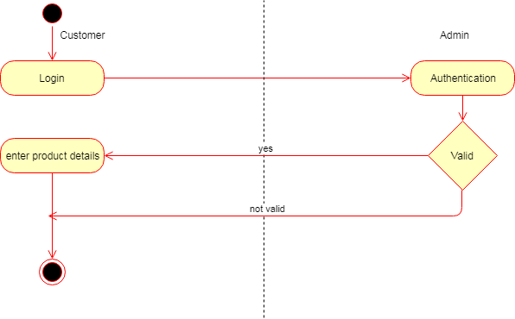
-> ACTIVITY DIAGRAM
Product Registration

Slide 15
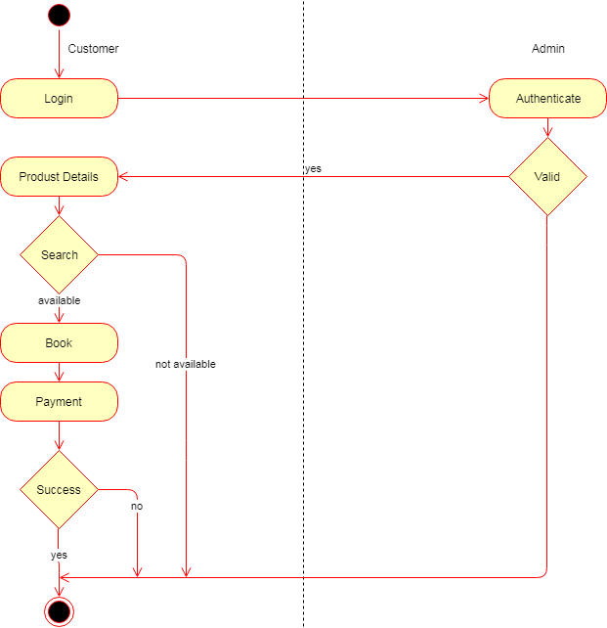
-> ACTIVITY DIAGRAM
Payment

Slide 16
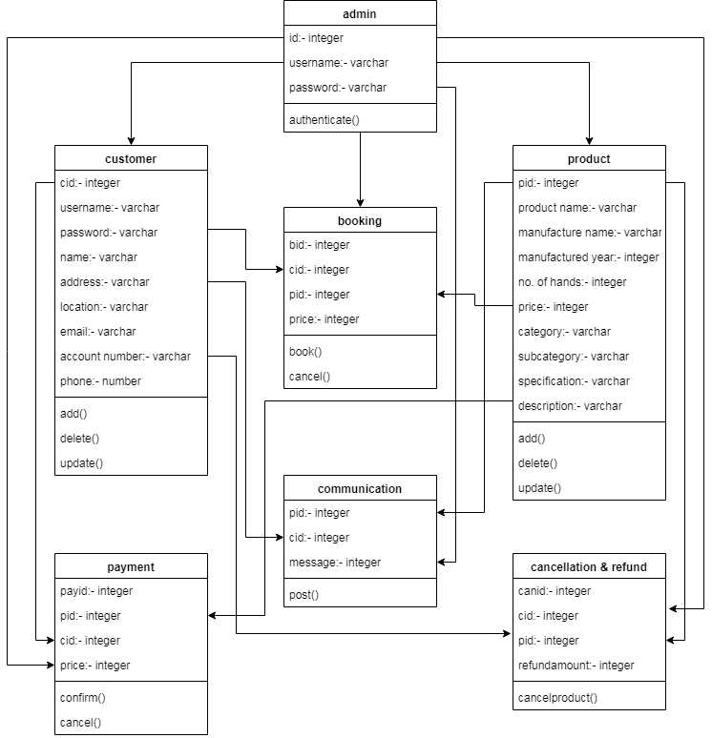
-> CLASS DIAGRAM

